Slide 1
Evaluation Metrics

Slide 2
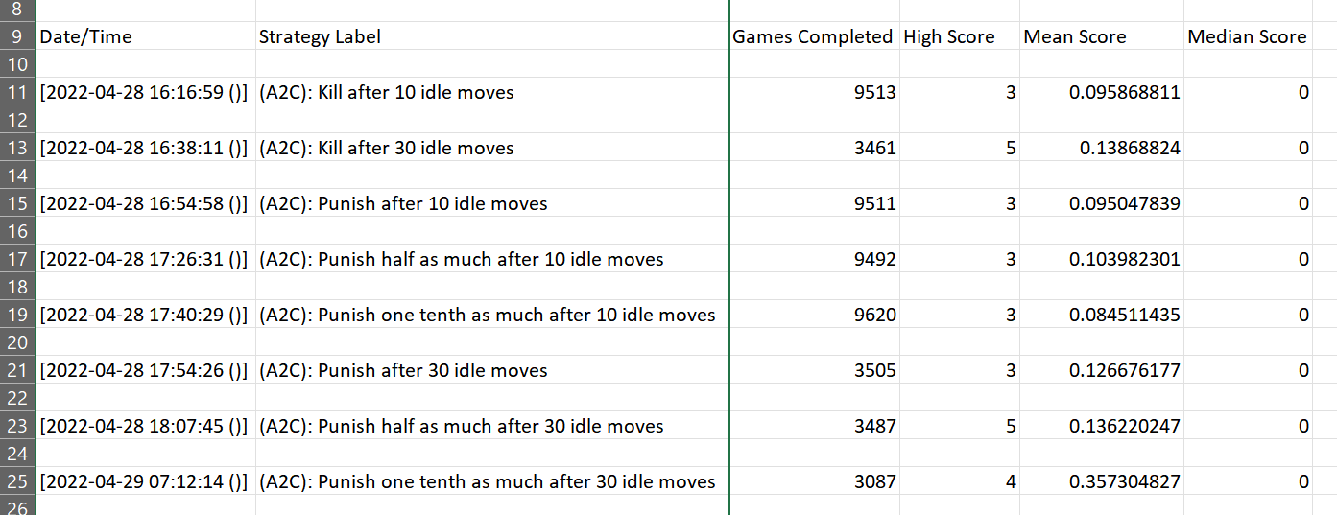
A2C Algorithm evaluation

Slide 3
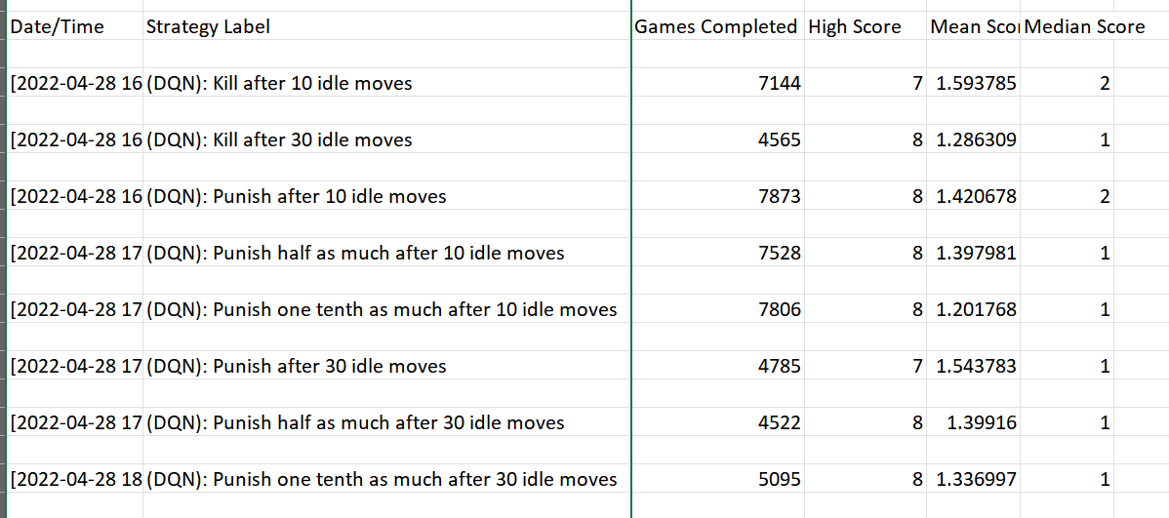
DQN Algorithm evaluation

Slide 4
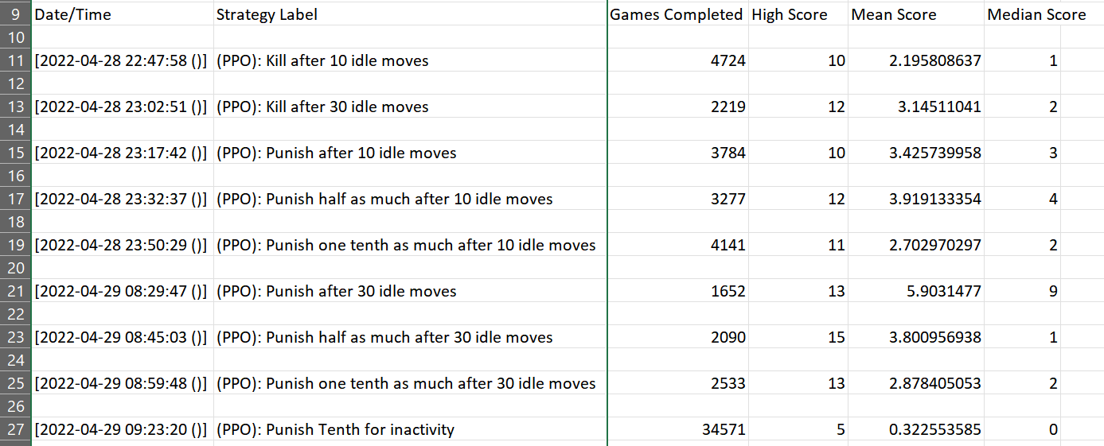
PPO Algorithm evaluation

